Slide 1
Access Switchboard Tutorial
--Report, Form, Switchboard, Macro
Morui Li

Slide 2
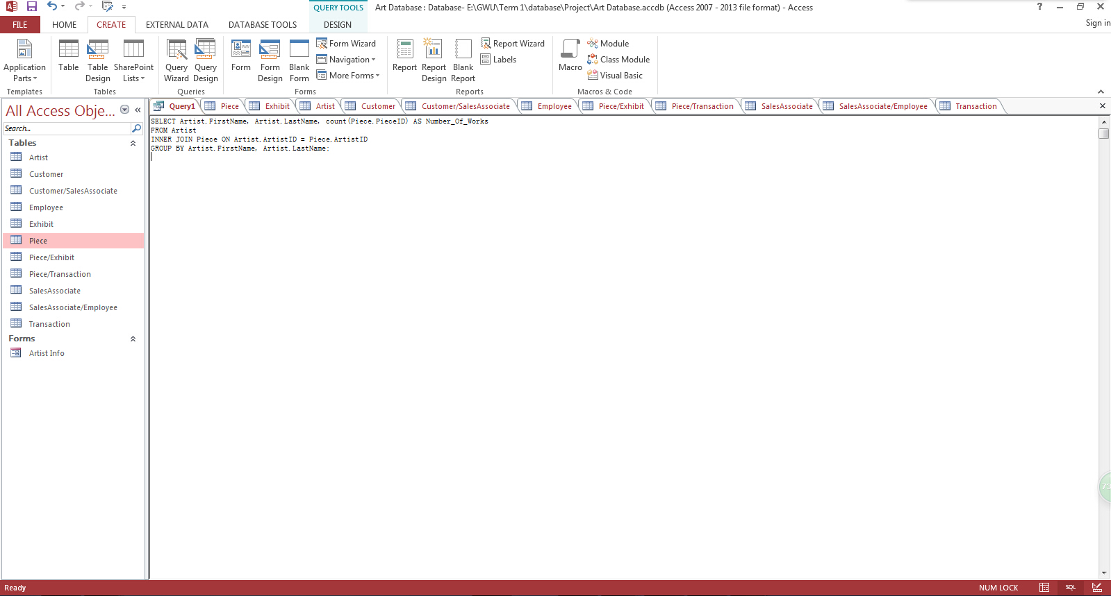
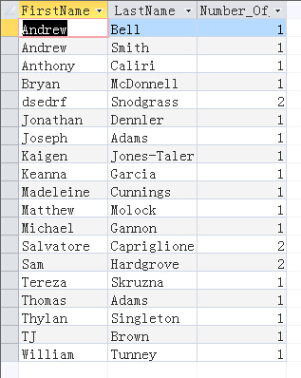
Report
After you create all the tables in the Access, you may want to create reports and forms first.
Report is a simple listing of records or a grouped summary of sales by region, you must first determine which fields contain the data you want to see in your report, and in which tables or queries they reside.
1. For a report, write and save your query first.

Slide 3
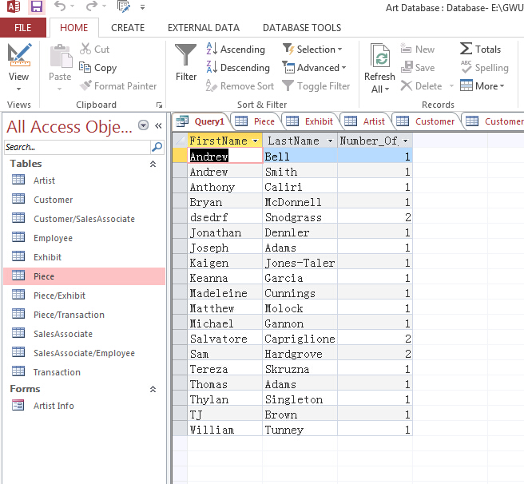
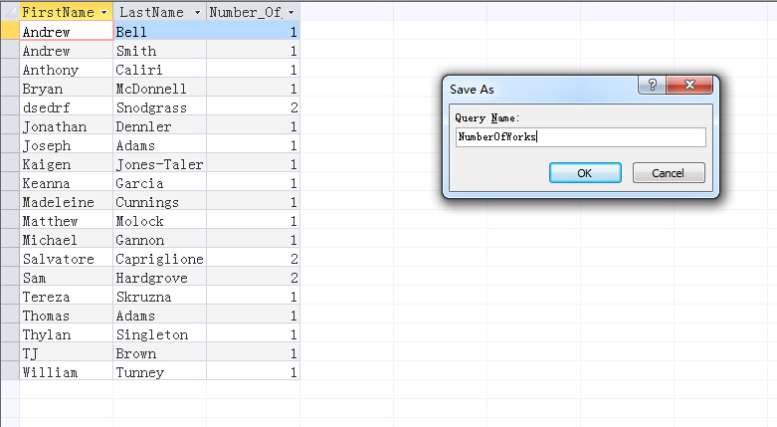
2. Save the query.

Slide 4
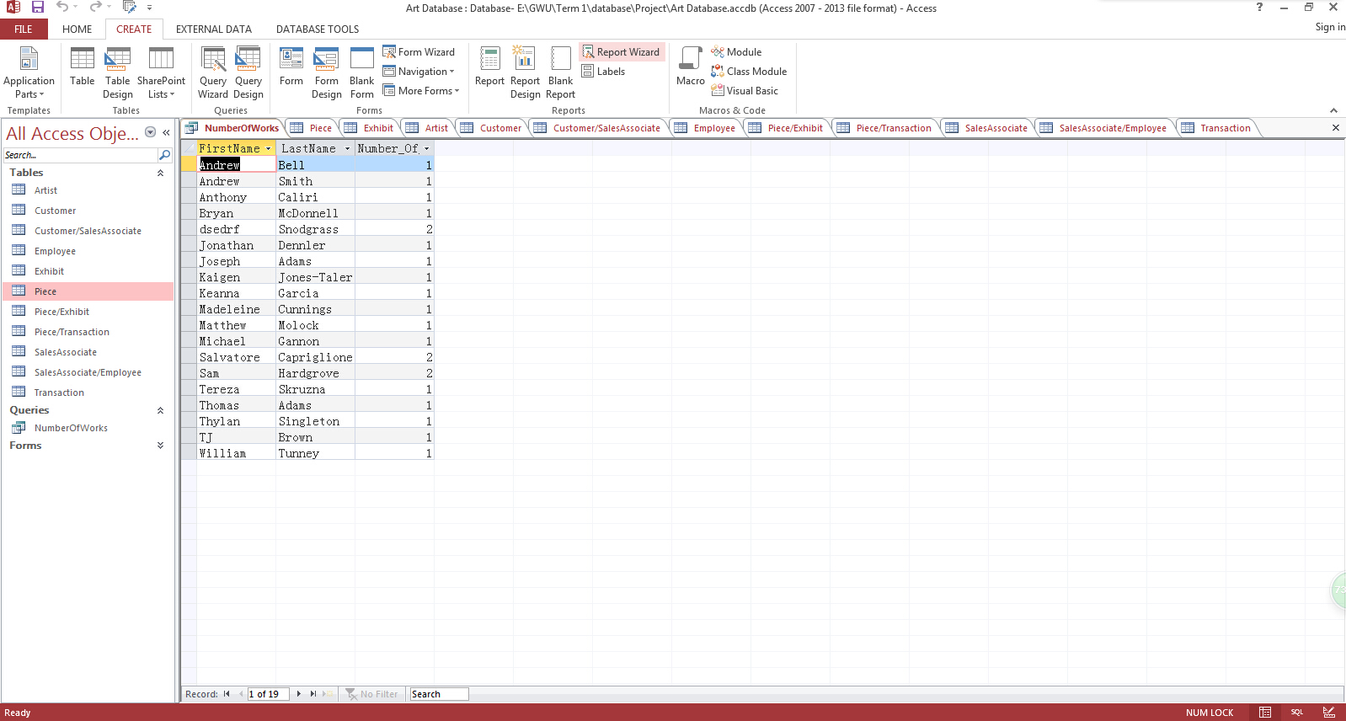
3. Under the CREATE tab, click on Report Wizard

Slide 5
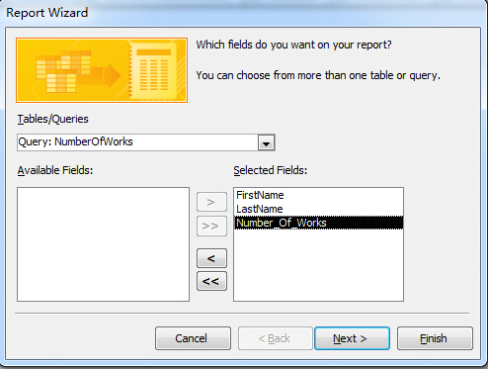
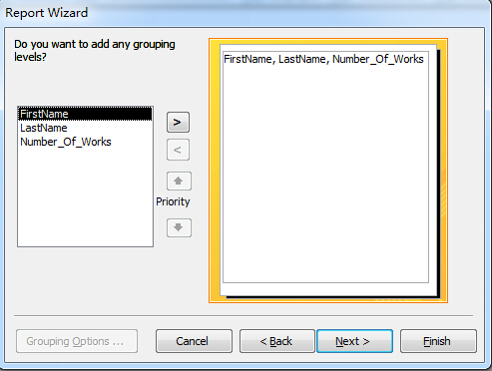
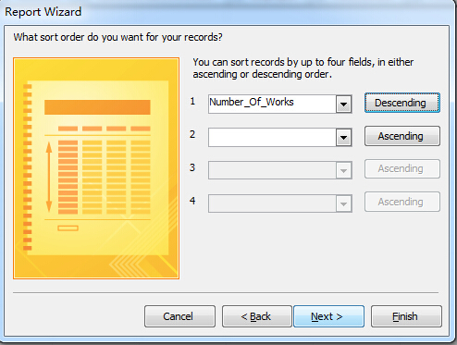
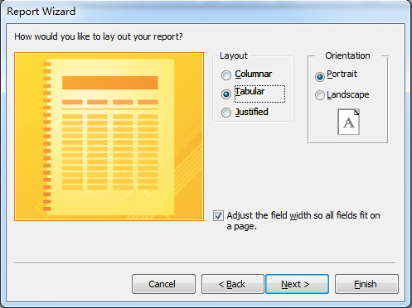
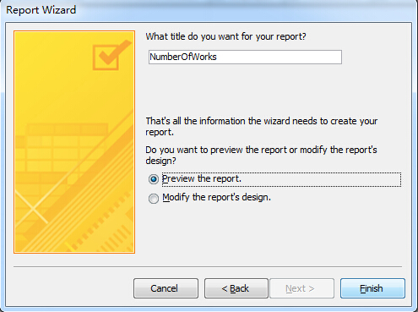
4. Choose your preference for the report
In the last step, u can also choose modify the report in the design view and edit it directly.

Slide 6
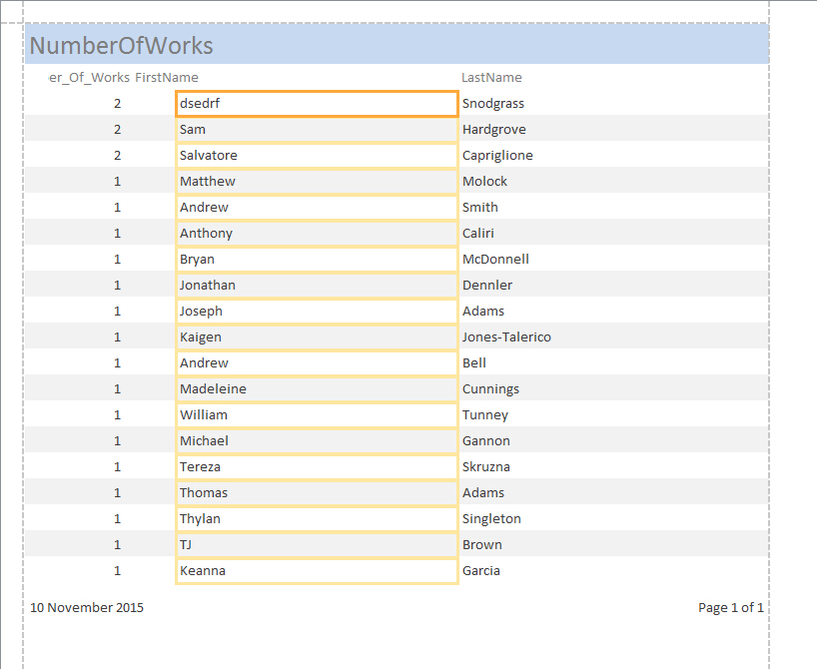
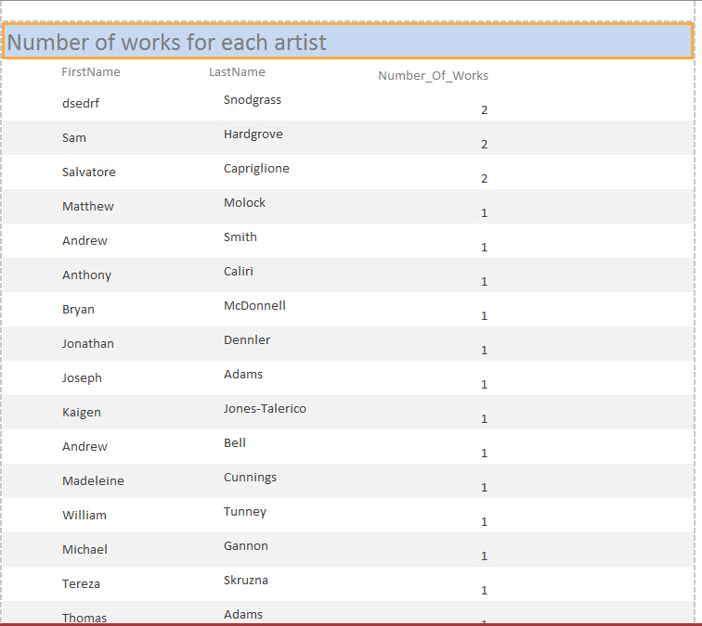
5. Now we are trying to modify our report in Layout View. You can drag or move on each column.
You can always go back and review your report in the Report View (the first icon).
modify

Slide 7
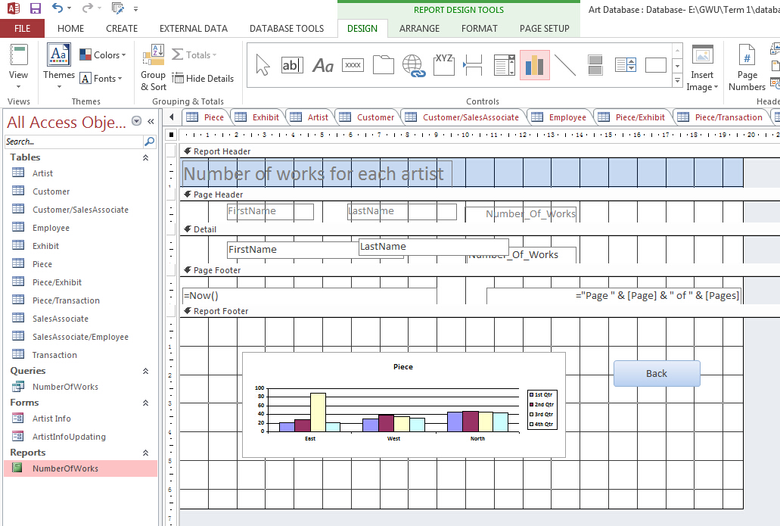
Put whatever you need in the report. Here is an example of place a chart inside it

Slide 8
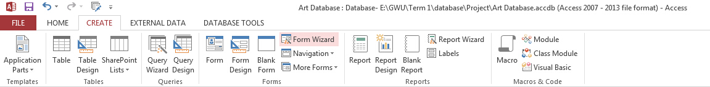
Form
Forms in Access are like display cases in stores that make it easier to view or get the items that you want. Since forms are objects through which you or other users can add, edit, or display the data stored in your Access desktop database.
1. For creating a form, click on the Form Wizard

Slide 9
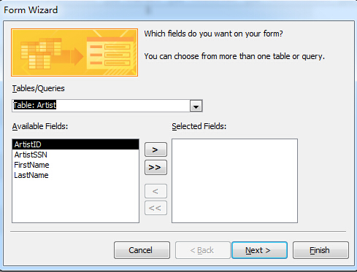
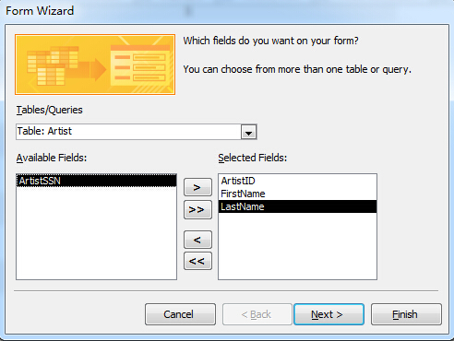
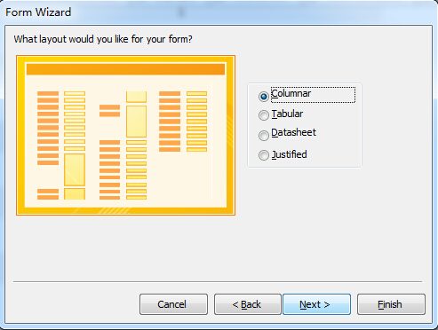
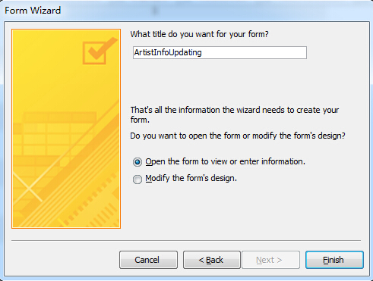
2. Choose your preference for the form. What you want the user to input or update.

Slide 10
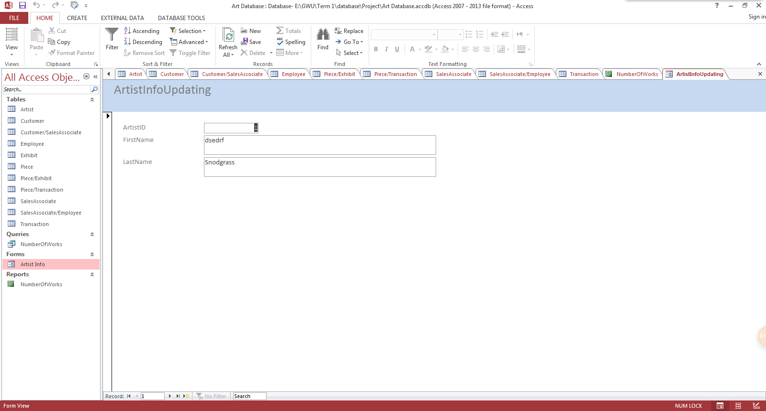
3. Make changes in Design/Layout View. Review the form in Form View

Slide 11
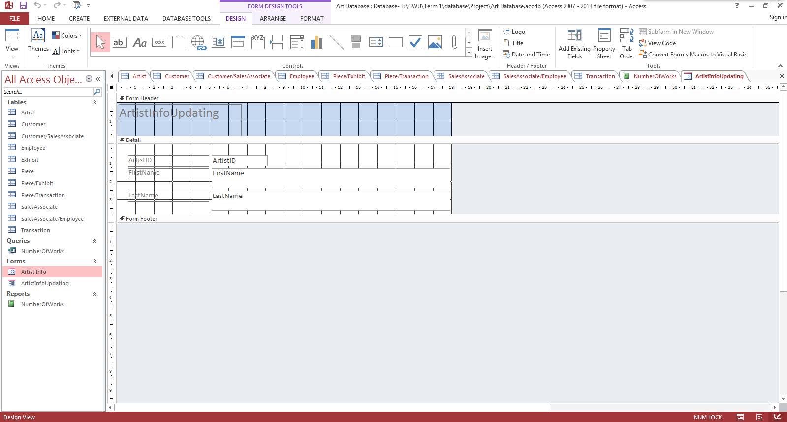
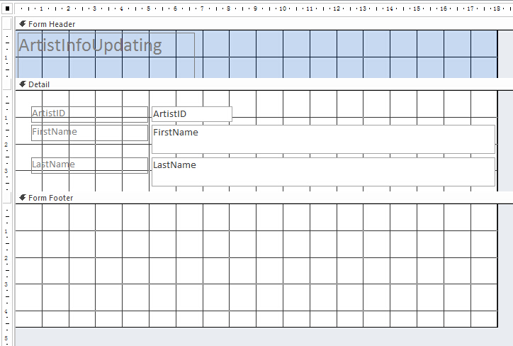
4. Add buttons. We will put the button in form footer. In the Design View, we drag the form footer down.

Slide 12
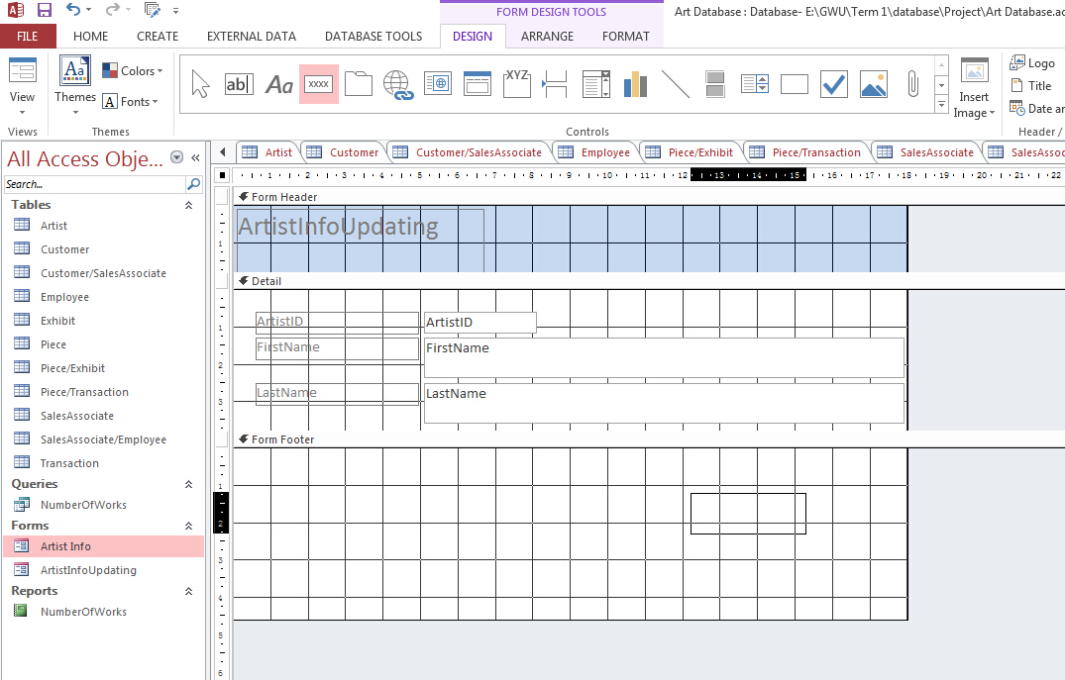
Under the DESIGN tab, click on the button icon and place your button in the footer area.

Slide 13
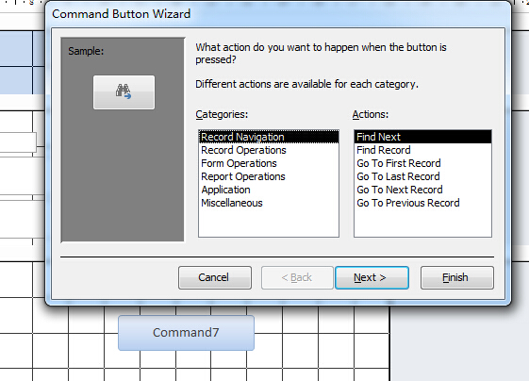
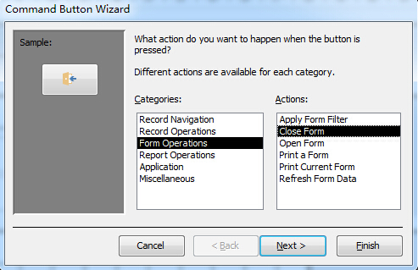
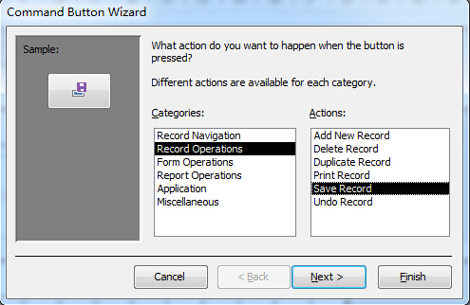
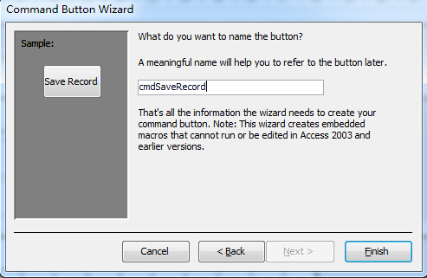
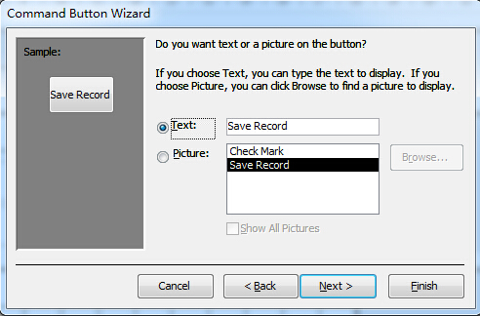
Button Wizard will show up. Choose your preference. You could Add/Save/Delete Record or Close Form

Slide 14
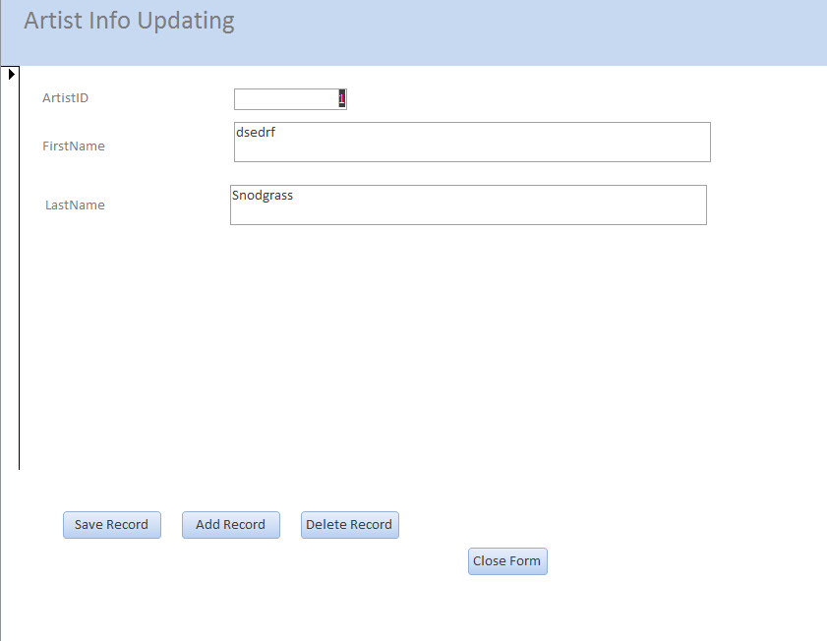
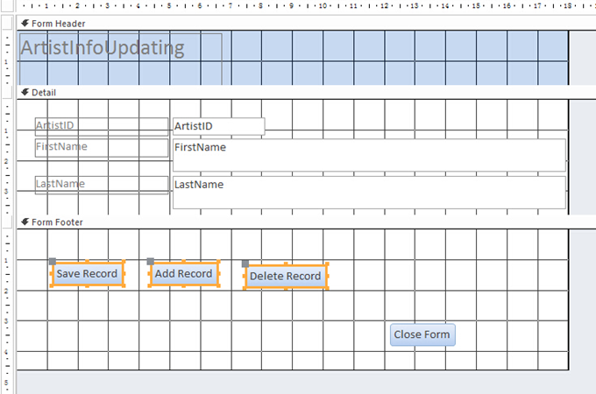
All the input in your form will be updating into your database

Slide 15
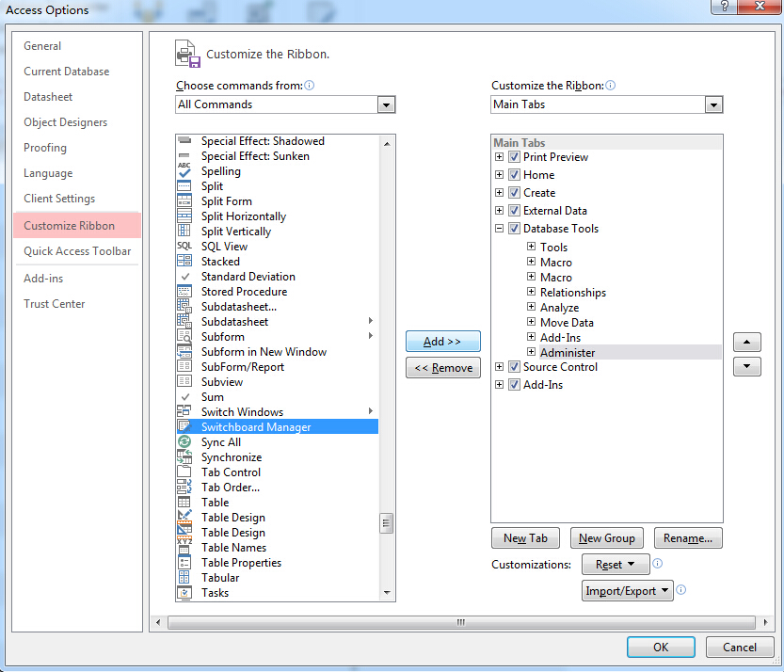
Switch Board
Add the Switchboard Manger in. File → Options → Customize Ribbon →All Commands → Add the Switchboard Manger
Access may ask you to create a new group for your customize choice.
Just click the new group button, Switchboard Manger will right under it.

Slide 16
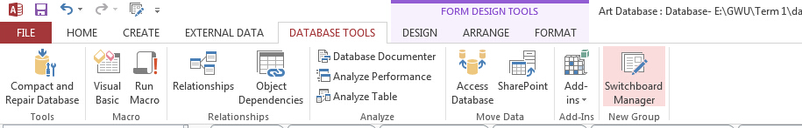
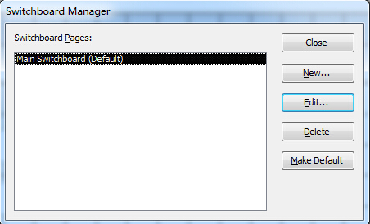
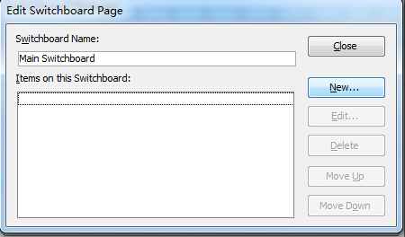
2. Click on the Switchboard Manager. Choose yes in creating the switchboard.
Once you get into the Switchboard Manager, double click on the Main Switchboard(default).
In Edit Switchboard Page, click on New.

Slide 17
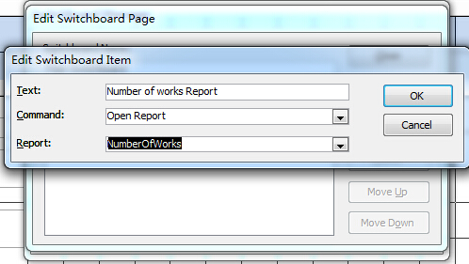
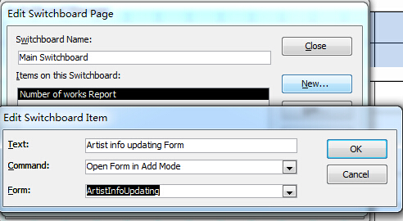
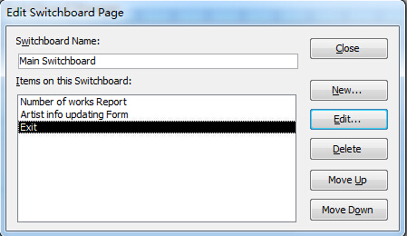
Choose the function and name for your switchboard item. If you made a sub-system, double click it and enter new items.

Slide 18
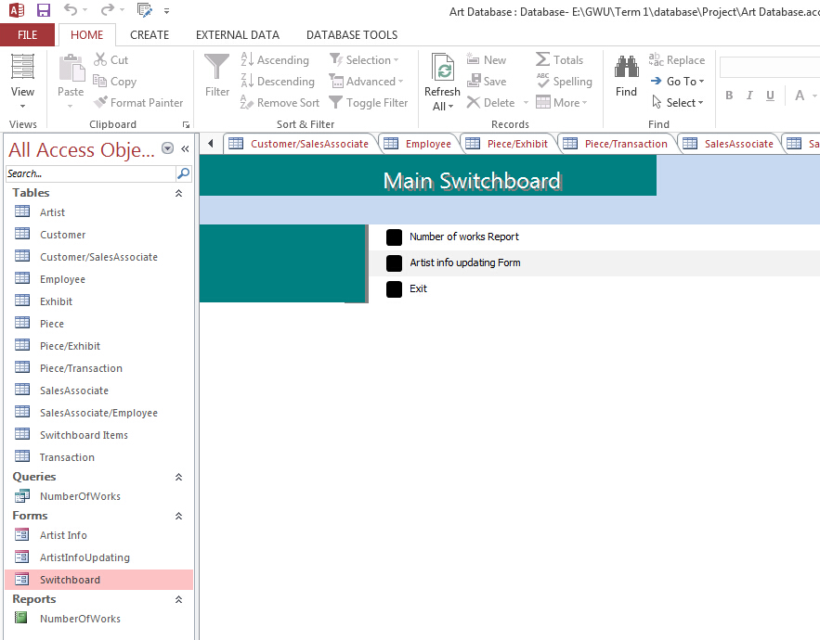
3. Make change in Design View and preview in Form view

Slide 19
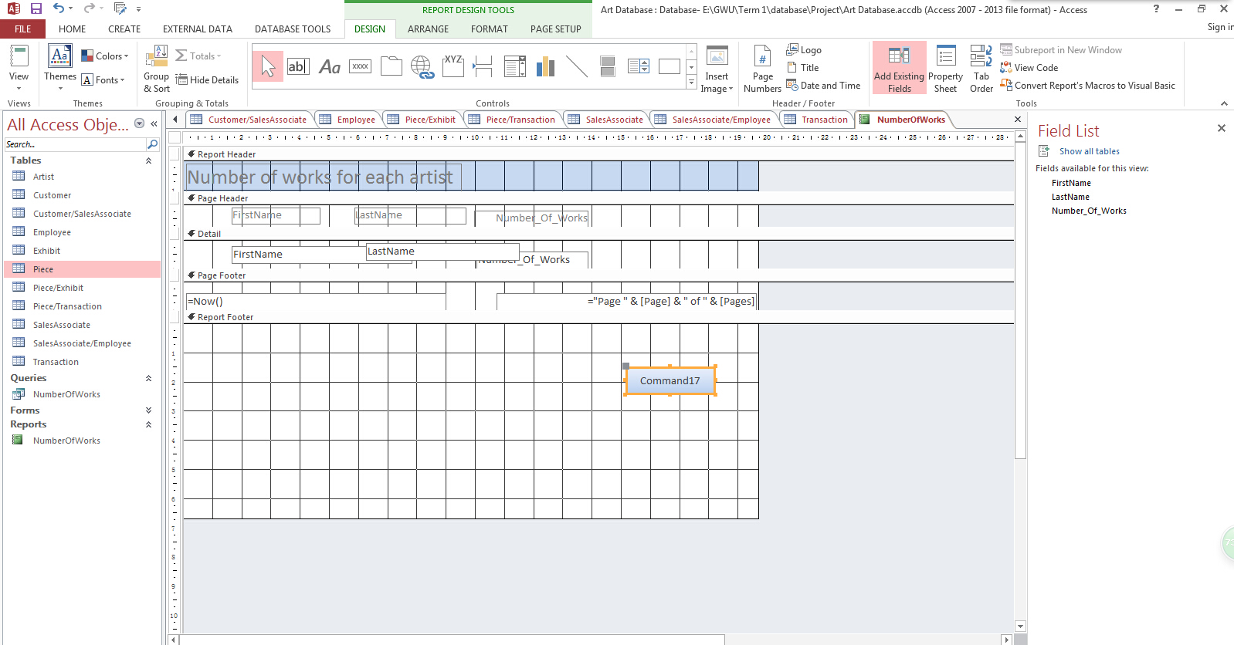
Macro
If the action list in the button wizard cannot satisfied you, then you could create your own Macro command.
For example, I open the report on switchboard and I want to go back to my switchboard by clicking a button. Here is how I use Macro command.
1. Add a button on the report page

Slide 20
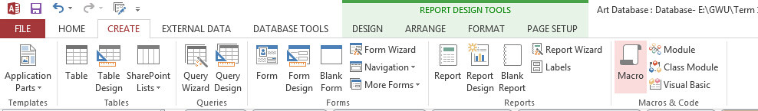
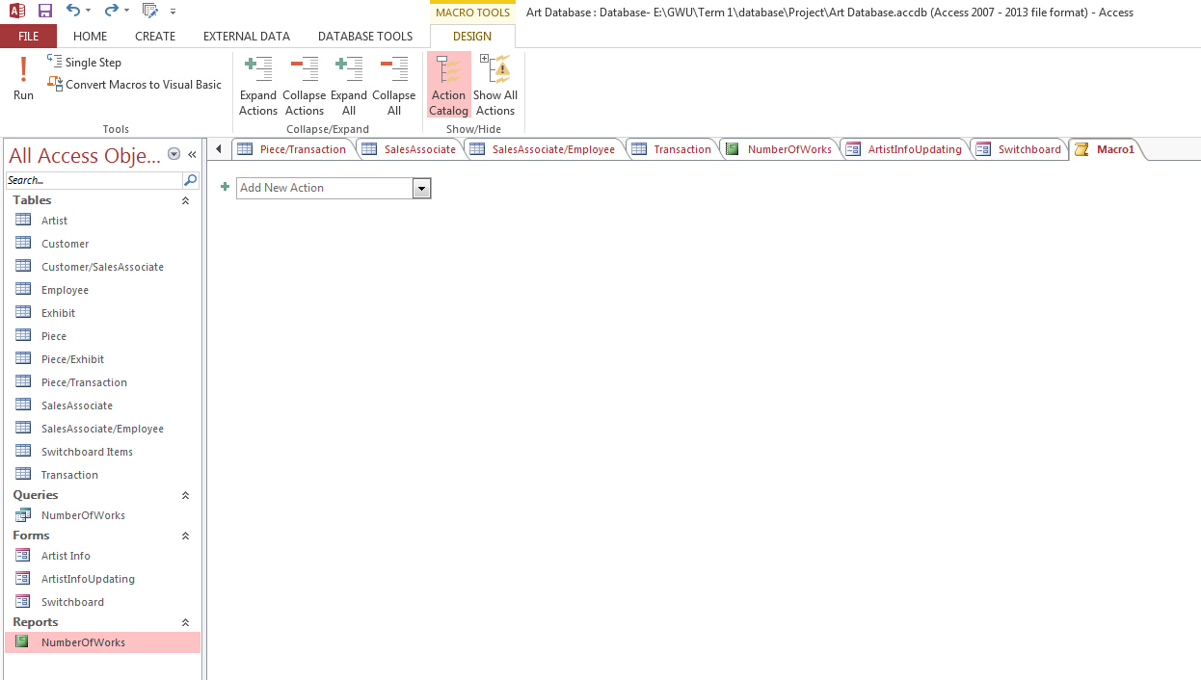
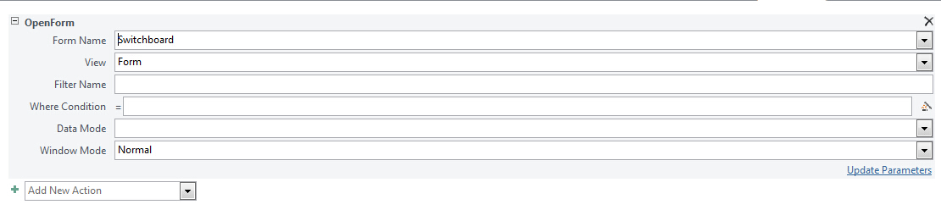
2. Under CREATE tab, click on Macro
3. Choose OpenForm in the drop down list.
(Since switchboard belongs to a form. So we want to open the form)

Slide 21
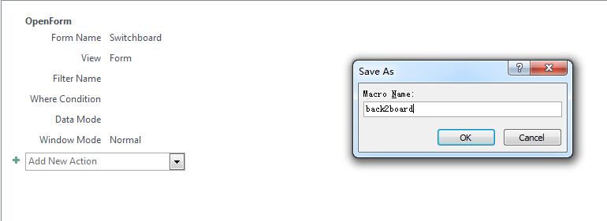
4. Save the Macro we have created. Go back to the button in the report.

Slide 22
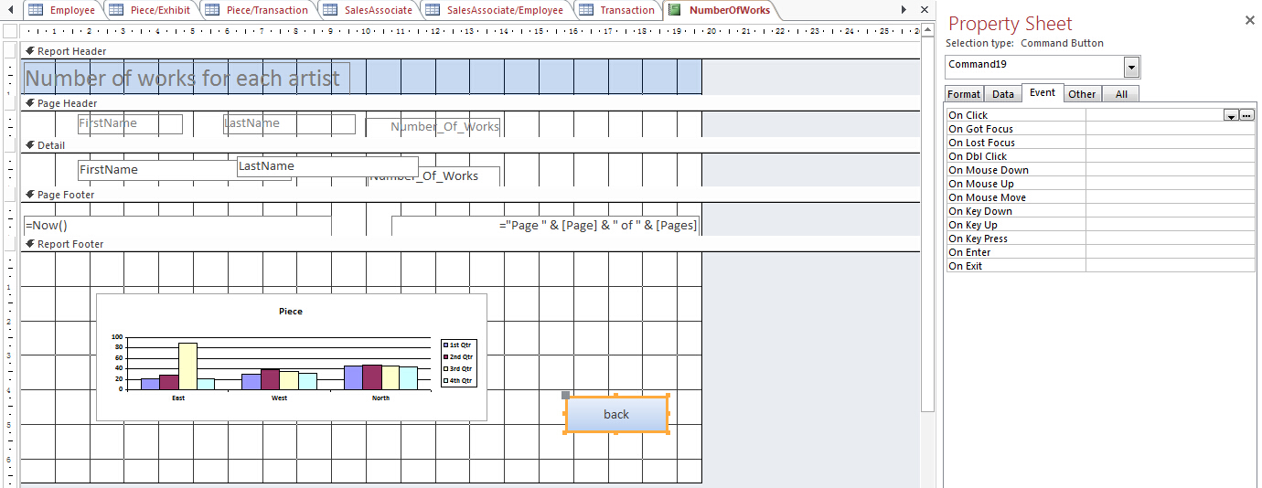
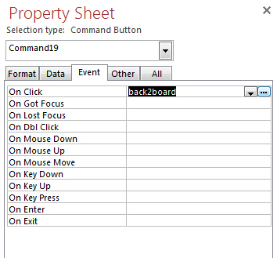
5. Click on the button and on the right side, a property sheet will show up. Choose the Event tab. In the drop down list for On Click, choose the macro we have created. I’ll choose back2board for here.
6. Go back to the Report View, try it !

Slide 23
Some resources online may also help you with form, report, and switchboard creating:
Form
https://www.youtube.com/watch?v=8PiD4awKjQw
2. Report
https://www.youtube.com/watch?v=KCYUtE_Fcvc
3. Switchboard
https://www.youtube.com/watch?v=MU4faNY3IZQ

